Slide 1

Particle Physics
Mass-charge ratio

Slide 2
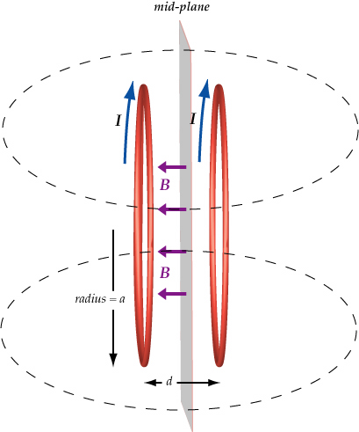
Particle Physics
How do we study particles?
One of the easiest ways to study a particle is to see how it moves in a magnetic or electric field
We can use coils to create a uniform field -> Helmholtz configuration
Notes:
A
Helmholtz configuration is an arrangement of two identical circular, co-axial coils, spaced apart by a distance equal to their radius.

Slide 3


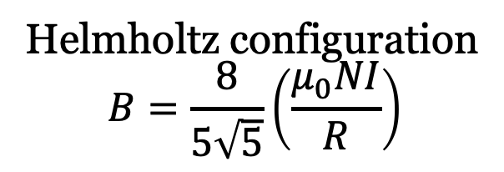

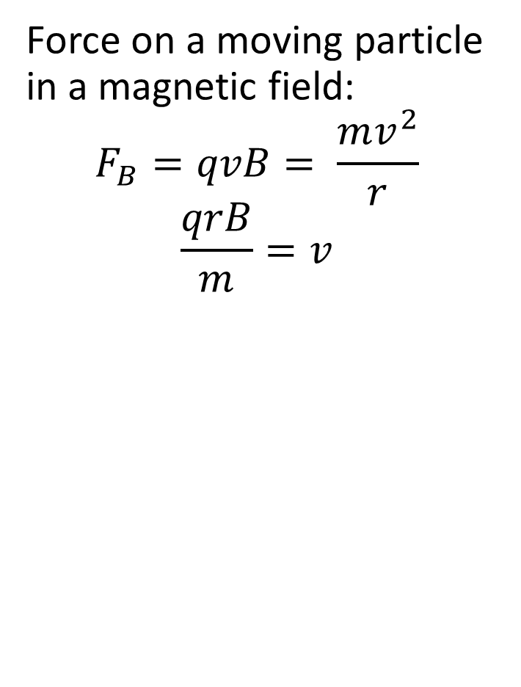
Derivation of equations
Energy for a particle in a potential difference:
$$ΔE=qΔV= \frac{1}{2}mv^{2}$$
$$\frac{2qΔV}{m}=v^{2}$$
Force on a moving particle in a magnetic field:
$$F_{B}=qvB= \frac{mv^{2}}{r}$$
$$\frac{qrB}{m}=v$$
Combining the two
$$\frac{2qΔV}{m}=v^{2}={\left(\frac{qrB}{m}\right)}^{2}$$
$$\frac{2ΔV}{B^{2}}=\left|\frac{q}{m}\right|r^{2}$$
Helmholtz configuration
$$B=\frac{8}{5\sqrt{5}}\left(\frac{μ_{0}NI}{R}\right)$$
$$\frac{125 R^{2} ΔV}{32 μ_{0}^{2}N^{2}I^{2}}=\left|\frac{q}{m}\right|r^{2}$$

Slide 4


Particle Physics
Seeing how a particle moves in a magnetic field using a Helmholtz configuration (to create a uniform field) allows us to find the charge-to-mass ratio $q/m$:
$$\frac{125 R^{2} ΔV}{32 μ_{0}^{2}N^{2}I^{2}}=\left|\frac{q}{m}\right|r^{2}$$

Slide 5
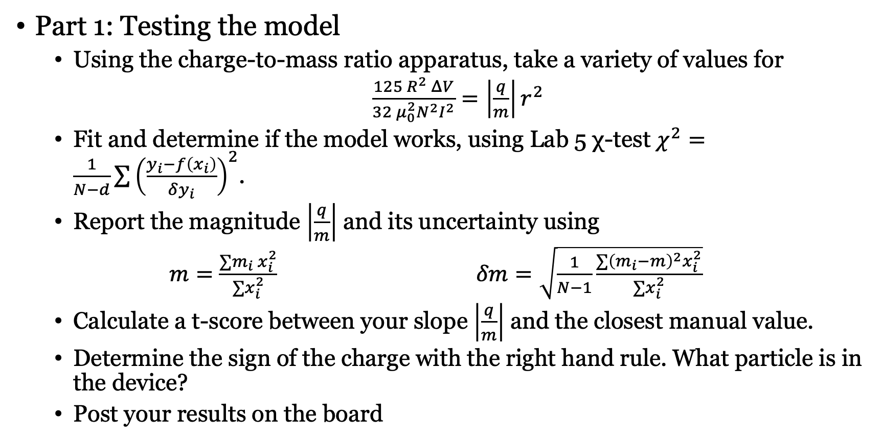
Lab 7 Part 1
Part 1: Testing the model
  Using the charge-to-mass ratio apparatus, take a variety of values for
  $\frac{125 R^{2} ΔV}{32 μ_{0}^{2}N^{2}I^{2}}=\left|\frac{q}{m}\right|r^{2}$
  Fit and determine if the model works, using Lab 5 χ-test $χ^{2}=\frac{1}{N−d}\sum{{\left(\frac{y_{i}−f\left(x_{i}\right)}{δy_{i}}\right)}^{2}}$.
  Report the magnitude $\left|\frac{q}{m}\right|$ and its uncertainty using
  $m=\frac{∑m_{i} x_{i}^{2}}{∑x_{i}^{2}}$ $δm=\sqrt{\frac{1}{N−1}\frac{∑{\left(m_{i}−m\right)}^{2}x_{i}^{2}}{∑x_{i}^{2}}}$
  Calculate a t-score between your slope $\left|\frac{q}{m}\right|$ and the closest manual value.
  Determine the sign of the charge with the right hand rule. What particle is in the device?
  Post your results on the board

Slide 6
Lab 7 - Safety
Safety
  Fragile apparatus: be careful taking the cover off and putting it back on
  No drinks on the tables

